Slide 1
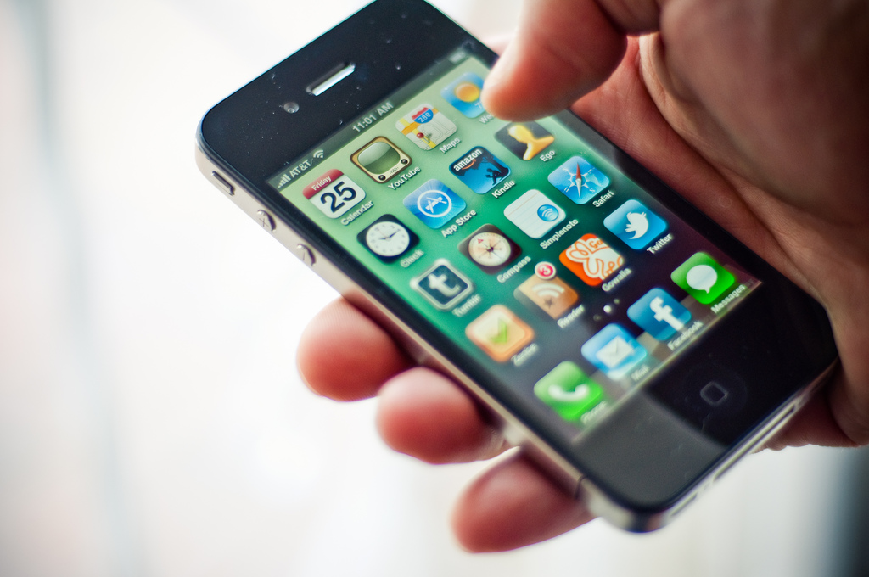
phoning
it in:
increasing student engagement using mobile phone polling
by andy burkhardt

Slide 5
96%

Slide 7
real time!
kinda…

Slide 8
free!
kinda…

Slide 9
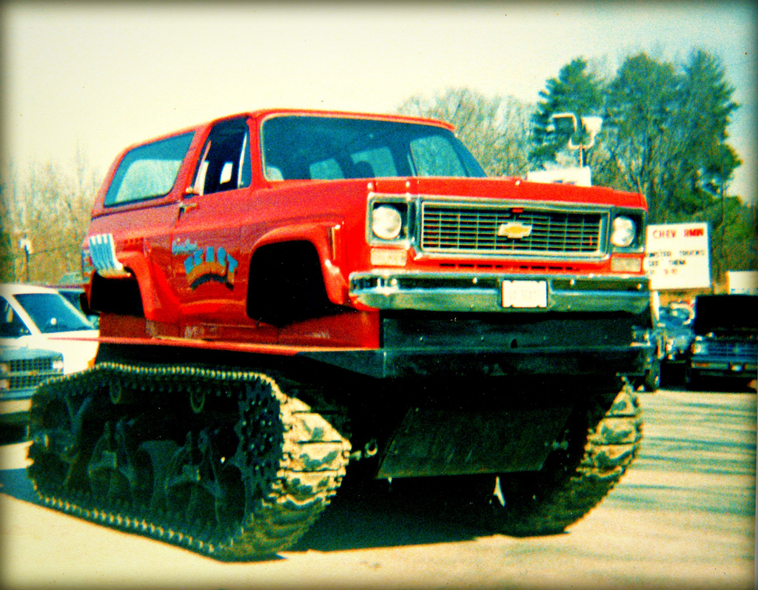
customization!

Slide 10
benefits!
of mobile polling in the classroom

Slide 11
ubiquitous
Notes:
"Communications tools don't get socially interesting until they get technologically boring," says Clay Shirky in his new book, Here Comes Everybody: The Power of Organizing without Organizations.

Slide 12
interactive

Slide 13
inexpensive

Slide 14
flexible

Slide 15
versatile

Slide 16
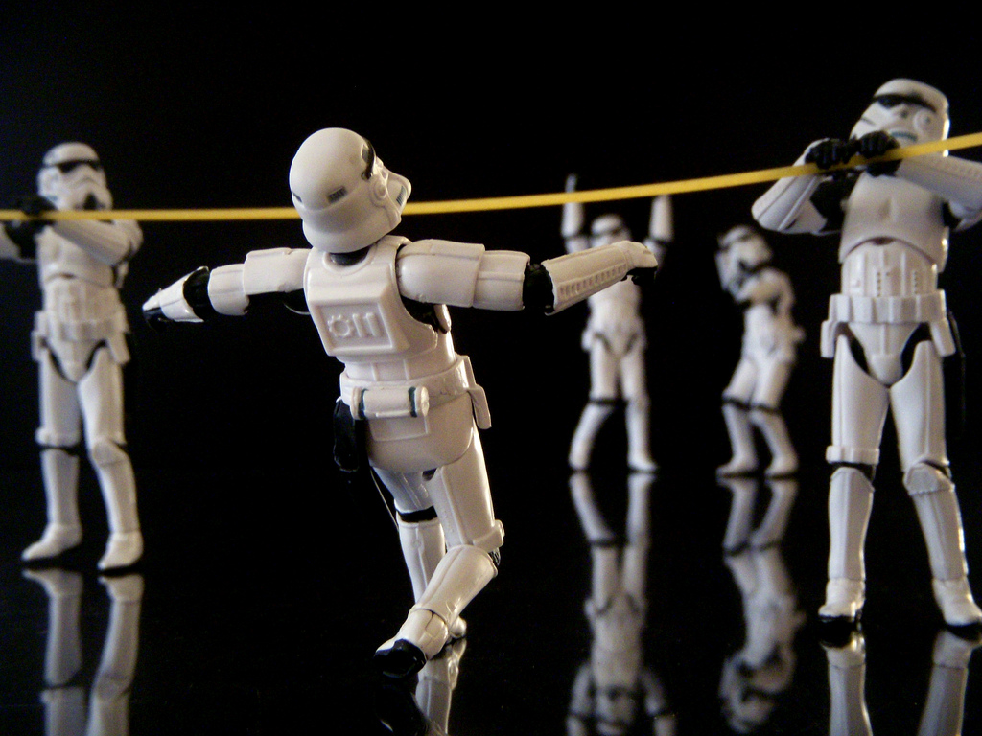
FUN!
fun

Slide 17
drawbacks
of mobile polling in the classroom

Slide 18
distractions?

Slide 19
no mobile phone?

Slide 20
cost?

Slide 21
web
troubles?

Slide 22
best
practices!

Slide 23
be prepared

Slide 24
have a backup plan

Slide 25
use
sparingly

Slide 26
“Rarely is the question asked: Is our [sic] children learning?”
~ George W. Bush
Notes:
There is such a thing as bad questions

Slide 27
types of questions

Slide 28
gauge understanding

Slide 29
gather data
or feed-back

Slide 30
voting

Slide 31
jumping off point

Slide 33
"Let my playing be my learning, and my learning be my playing."
~ Johann Huizinga

Slide 35
images
1. flickr | The iPhone 4 | Jose Quinteros
3. flickr | sleeping kid in NSC | rofltosh
4. flickr | Tase me bro! | Chuckumentary
5. flickr | Sneaky Messages | Tommy Huynh
6. Poll Everywhere logo
9. flickr | Virginia Beach Beast – Mid 80s | steviep187
11. flickr | Trans Siberian Orchestra Concert – People Waving their Cellphones In The Dark | Anirudh Kuhl
12. flickr | interactive | leonardo.bonanni
13. flickr | Quarter (for the DPP Scavenger hunt) | cursedthing
14. flickr | Great Flexibility | khalid almasoud
15. flickr | Versatile | Samyra Serin
16. flickr | Military Maneuvers | JD Hancock
18. flickr | UofT Grad: Texting | balleyne
19. flickr | Out of Luck | Sharon Drummond
20. flickr | Sale on Cash Register | tibchris
21. flickr | Unpluggered for Safties | Nomadic Lass
23. flickr | At camp with the 23rd West Ham Scouts | theirhistory
24. flickr | Backups are important | godog
25. flickr | Blair’s Mega Death Sauce | wstryder
28. flickr | 140 PSI | Michael Connell
29. flickr | suggestion box | sethoscope
30. flickr | Liberian’s Vote in Constitutional Referendum | United Nations Photo
31. flickr | Jump! | chepedaja
34. flickr | Question! | Stefan Baudy

Slide 36
andy burkhardt
http://andyburkhardt.com
http://twitter.com/vonburkhardt
andrew.burkhardt@gmail.com

