Slide 1
The Art of redirection
Putting Mobile Devices Where You want them

Slide 2
Based on experiences at . . .
The University of New Mexico
Health Sciences Library and Informatics Center
MSC09 5100
1 University of New Mexico
Albuquerque, NM 87131-0001

Slide 3
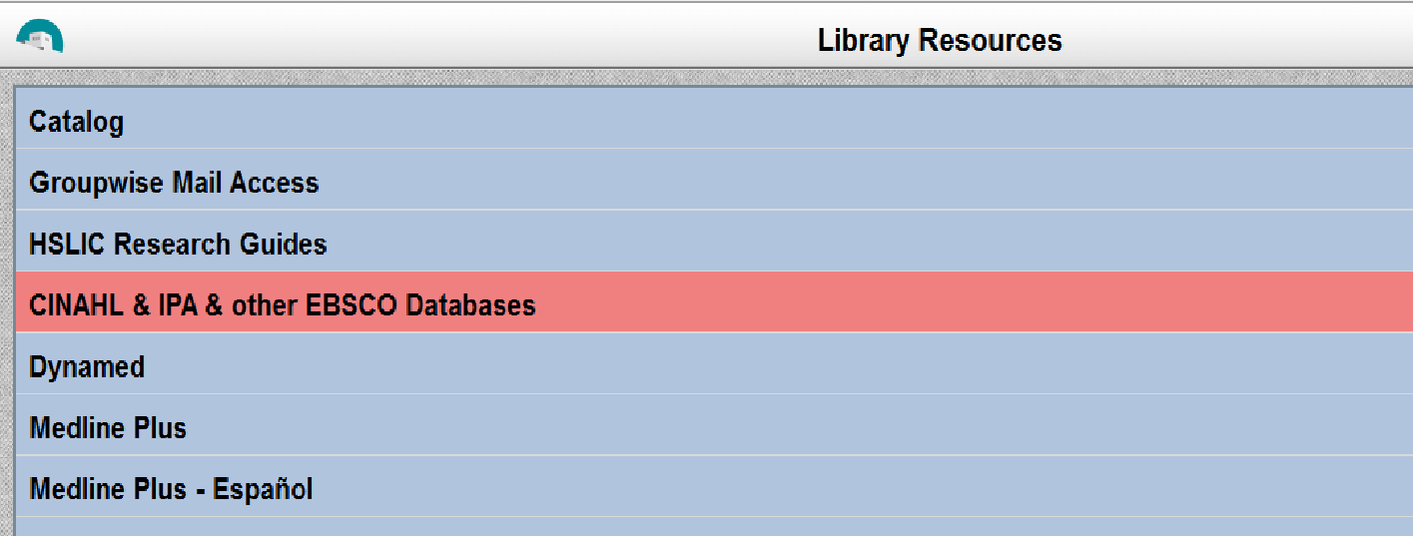
In the beginning . . . We had a mobile site

Slide 4
But to get to it . . .
We started out with a link on the homepage
Visitors had to know to look for the link
Visitors had to find the link
Visitors had to know what “HSC Mobile” meant
Visitors had to have a device capable of loading the full homepage first

Slide 5
So we decided to employ redirect script
Automatically redirects mobile devices to the mobile site
Keeps devices from having to load the full homepage
Makes mobile experience more seamless
Minimizes confusion/frustration

Slide 6
What is script?
Scripting languages are lightweight programming languages
Client side script (Javascript) runs in the browser window
Server side runs on the server
Allows for dynamic page elements

Slide 7
Why use javascript?
Easy to implement
More flexibility in device detection
Works without requiring access to server side scripting

Slide 8
Why use server side script?
Cannot be turned off by user
Visitors cannot read source code

Slide 9
The basic stages of a mobile redirect
Device detection
Redirection

Slide 10
Device detection
Possible detection modes:
Screen size
Operating system
Browser
Rely on a Device Description Repository (such as WURFL)

Slide 11
Device detection with javascript
Allows direct access to the Document Object Model
Some devices have Javascript deactivated by default

Slide 12
Device detection with server side script
Relies on the User Agent string
This information can be inaccurate for a variety of reasons
Notes:
Can write javascript with php, but this is still useless if javascript is turned off

Slide 13
redirection
Easily accomplished with either type of script
However, Javascript can be turned off
Notes:
Can write javascript with php, but this is still useless if javascript is turned off

Slide 14
Basic javascript redirect
if (screen.width <= 800)
{
window.location = "http://m.health.unm.edu/";
}
Place in header
Redirects all devices based on screensize
Notes:
Can write javascript with php, but this is still useless if javascript is turned off

Slide 15
Problems with this approach
Doesn’t offer visitors options
The inability to select the regular webpage
May irritate tablet users
May irritate users of high end smartphones
Notes:
Can write javascript with php, but this is still useless if javascript is turned off

Slide 16
Hslic redirect 2.0
if ((screen.width <= 800) && (document.referrer != "http://m.health.unm.edu/library/landingsite.html") )
{
window.location = "http://m.health.unm.edu/library/landingsite.html";
}
Notes:
Can write javascript with php, but this is still useless if javascript is turned off

Slide 17
Hslic redirect 2.0
Still works off of screen size
Sends mobile visitors to a selector screen
Checks previous page to keep visitors from looping
Notes:
Can write javascript with php, but this is still useless if javascript is turned off

Slide 18
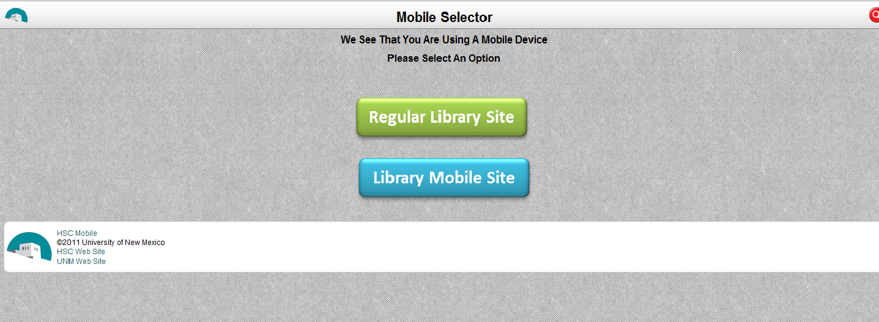
Hslic redirect 2.0
Notes:
Can write javascript with php, but this is still useless if javascript is turned off

Slide 19
A new problem: cloning
When a new page started redirecting, it was investigated
The page authors cloned our homepage
The redirect script was included unintentionally
Solution: change the redirect “IF” clause
Notes:
Can write javascript with php, but this is still useless if javascript is turned off

Slide 20
Hslic redirect 3.0
if ((screen.width <= 800) && (document.referrer != "http://m.health.unm.edu/library/landingsite.html") &&
(window.location == "http://hsc.unm.edu/library/ "))
{
window.location = "http://m.health.unm.edu/library/landingsite.html";
}
Notes:
Can write javascript with php, but this is still useless if javascript is turned off

Slide 21
Hslic redirect 3.0
New IF clause only works if the redirect is originating from the designated page
Keeps cloning from being an issue
Notes:
Can write javascript with php, but this is still useless if javascript is turned off

Slide 22
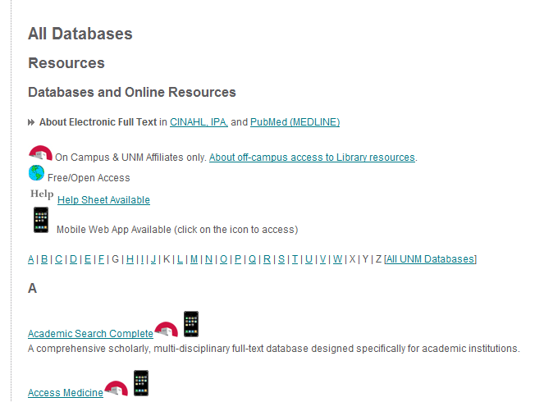
Other routes to mobile interfaces
HSLIC uses links from mobile icons on the database list page
Notes:
Can write javascript with php, but this is still useless if javascript is turned off

Slide 23
What about native apps?
Databases in the list that have a native app version link to a selector like this
Notes:
Can write javascript with php, but this is still useless if javascript is turned off

Slide 24
What has this done for hslic?
Significantly increased visitor numbers for the mobile site
Has allowed the Library to simplify the new homepage
Notes:
Can write javascript with php, but this is still useless if javascript is turned off

Slide 25
The future
Responsive Web Design allows for pages that adjust to mobile devices
Sites designed in this manner:
Serve multiple devices with a single site
Provide a seamless mobile experience

Slide 26
NEW NEW NEW
Due to the increased pixel density of the new iPads, HSLIC has added a User Agent check to its script in addition to a screen size test. It has not been tested on a new iPad yet, but the new script continues to work with older devices. The new script is:
<script type=”text/javascript”>
if (((screen.width <= 800) && (document.referrer
!= "http://m.health.unm.edu/library/landingsite.html"))
|| ((navigator.userAgent.indexOf('Mobile') != -1) && (document.referrer
!= "http://m.health.unm.edu/library/landingsite.html")))
{
window.location = "http://m.health.unm.edu/library/landingsite.html";
}
</script>

Slide 27
Questions?
?

Slide 28
Further reading
Knight K. Responsive Web Design: What It Is and How To Use It. Smashing Coding [Internet]. [cited 2012 Jan 14]:[about 2:30 p.]. Available from: http://coding.smashingmagazine.com/2011/01/12/guidelines-for-responsive-web-design/
App to generate a PHP redirect function to your specifications: http://detectmobilebrowsers.mobi/
Mobile redirection with PHP: http://www.mlynn.org/2010/06/mobile-device-detection-and-redirection-with-php/

